Slide 1
Challenge 4 cloud based data collection and visualization
Team members:
Shisheng wang
xiangtian yi
Ye xing
Yanlin zhou

Slide 2
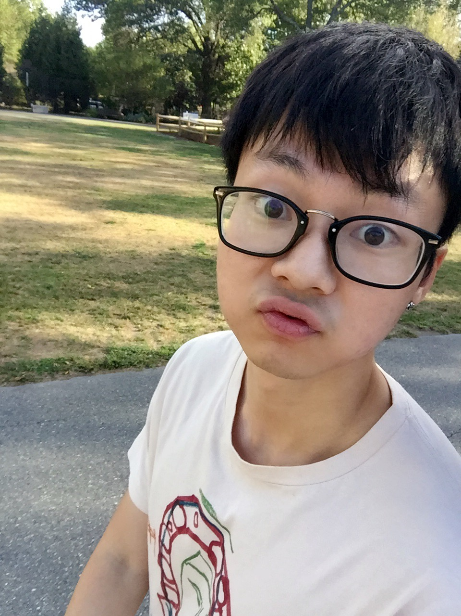
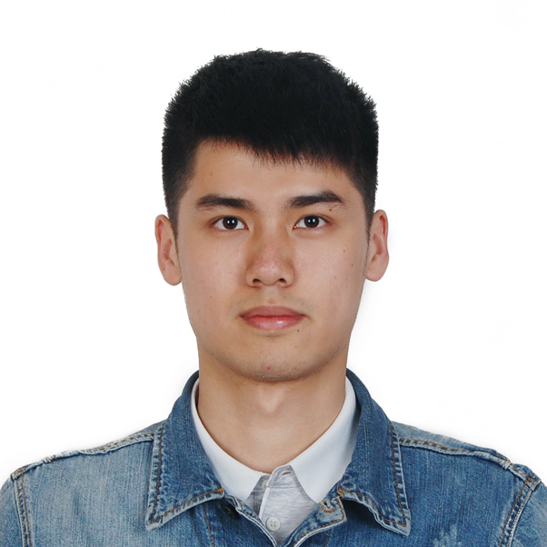
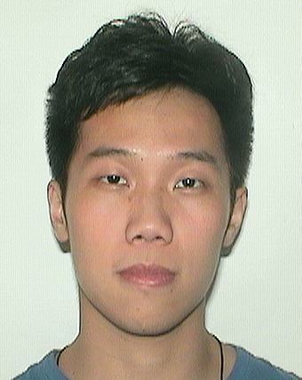
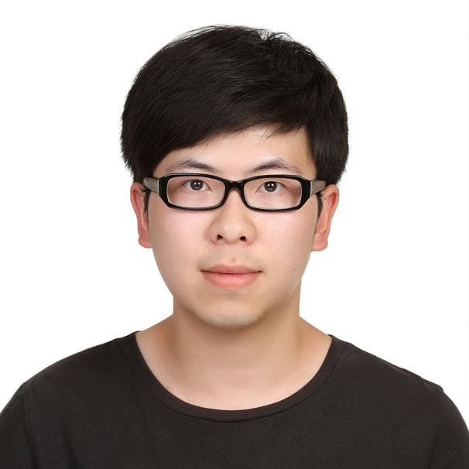
Presenter on this challenge
 | Xiangtian | Shisheng | Ye | Yanlin
Challenge 1 | Presenter
Challenge 2 |  | Presenter
Challenge 3 |  |  | Presenter
Challenge 4 |  |  |  | Presenter
Challenge 5 | Presenter
Challenge 6 |  | Presenter
Challenge 7 |  |  | Presenter
Challenge 8 |  |  |  | Presenter

Slide 3
TEAM WORK
Xiangtian | Shisheng | Ye | Yanlin
I connected the data gathered from Photon to mysql database, and extracted data from the database and presented it on the chart. Tried to implemented the particle environment on pi. | I build the local cloud to make photon able to switch between local and particle.And I modify the node.js code from challenge2 to make data able to transfer from particle to local database and web transfer. | I helped setting up the router and particle environment in the pc. Upgraded the .ino file to calculate the temperature received from Photon. | In this challenge, I modified the front – end and engaged in implementing the particle cloud and transferring data from particle to the javascript page.

Slide 4

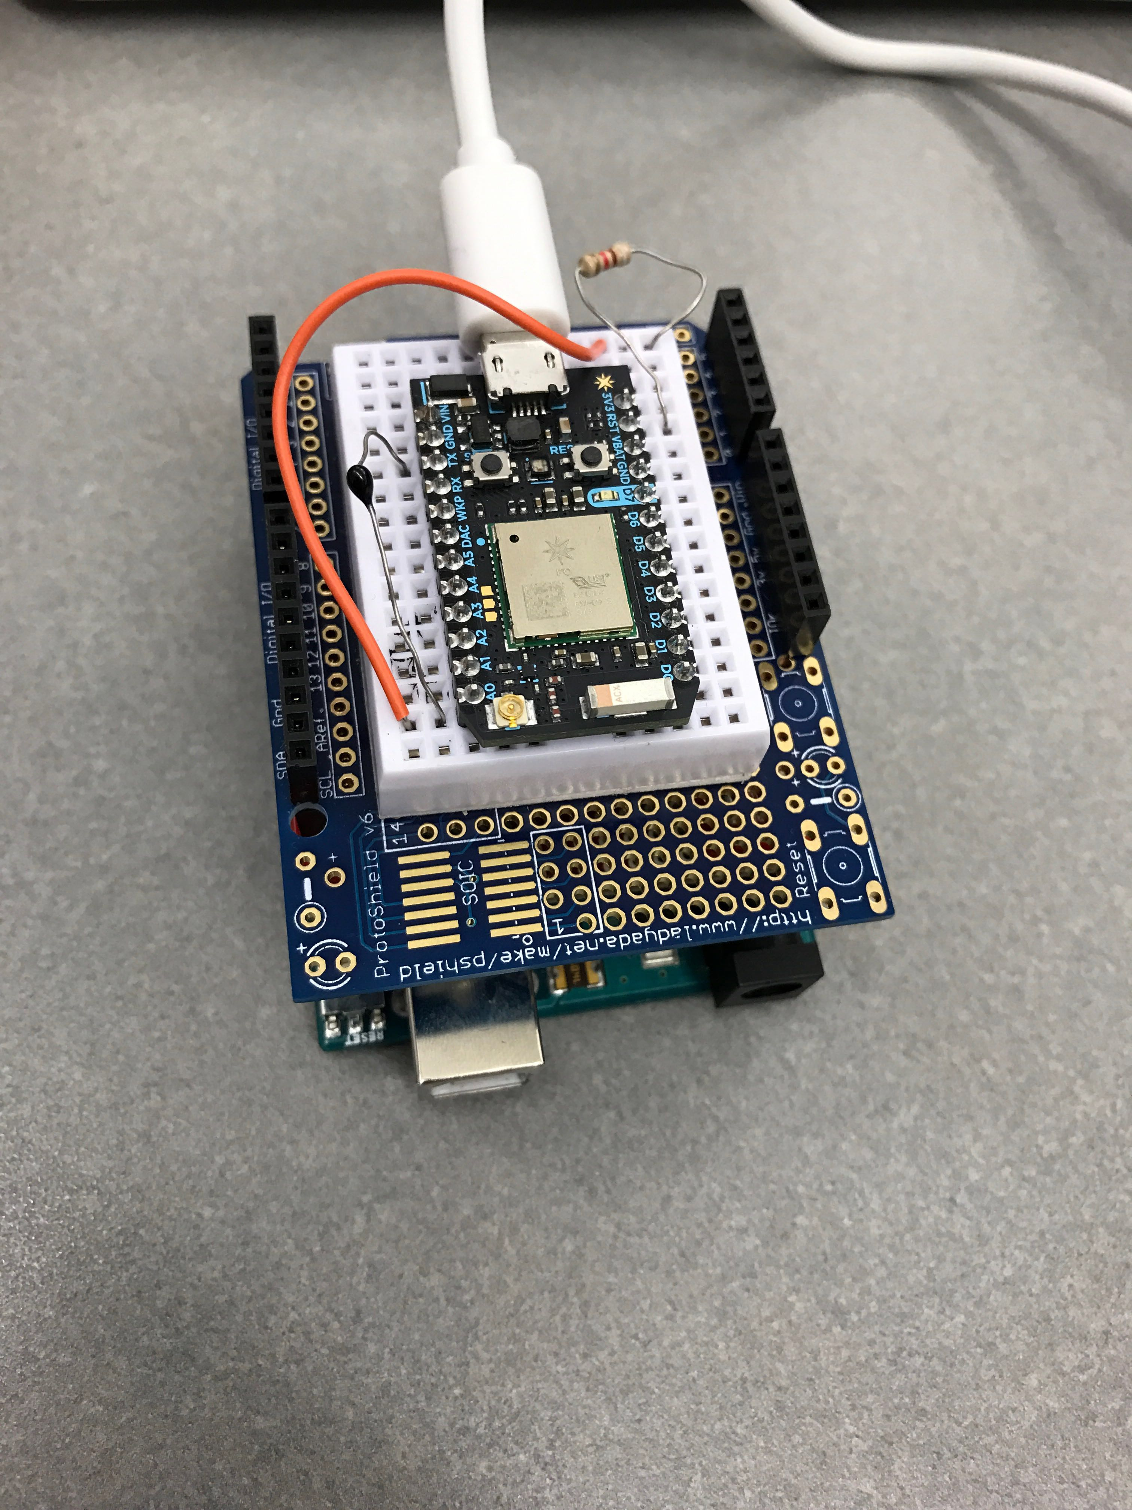

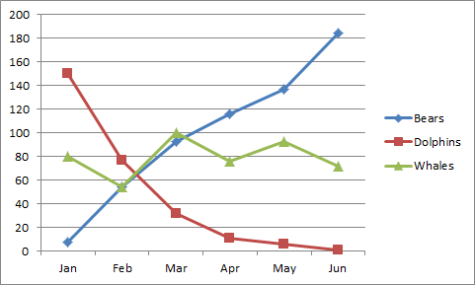
architecture
Internet
Local

Slide 5
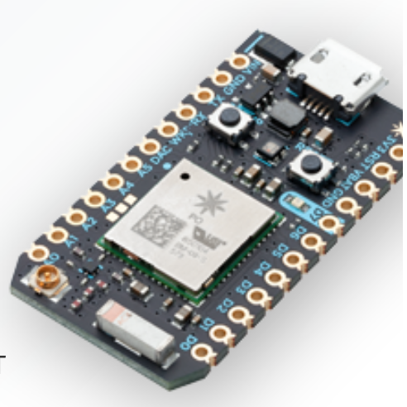
architecture
Internet
Local

Slide 6
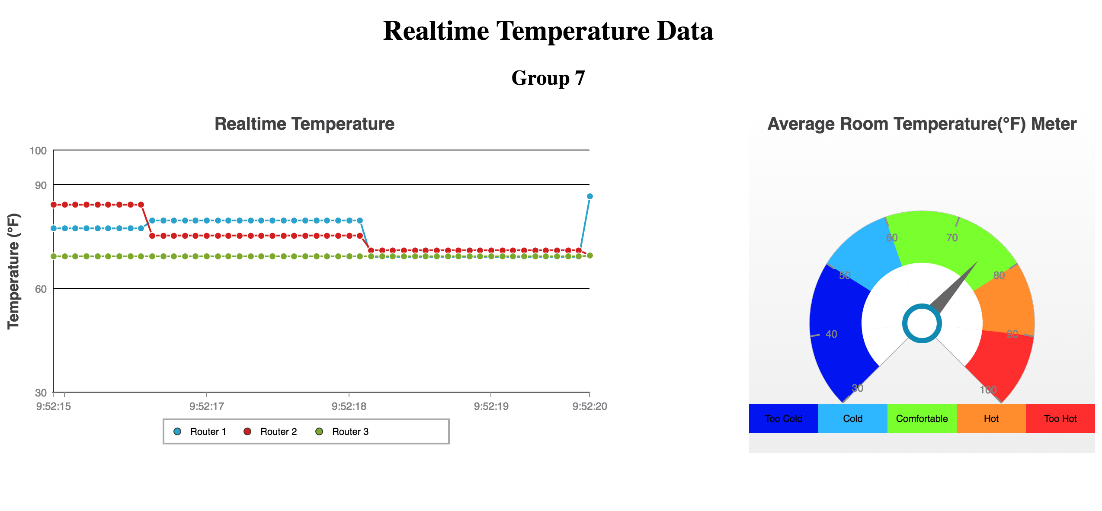
Measures temperature at each device in real time
and displays strip chart of real time data from each devices
Data persistence

Slide 7
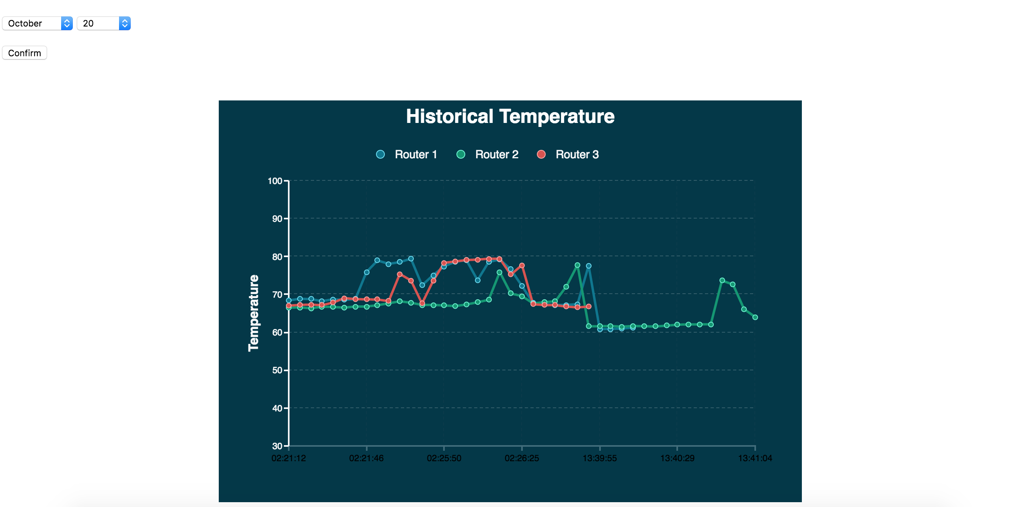
Achieves display of historical data selected by time interval

Slide 8
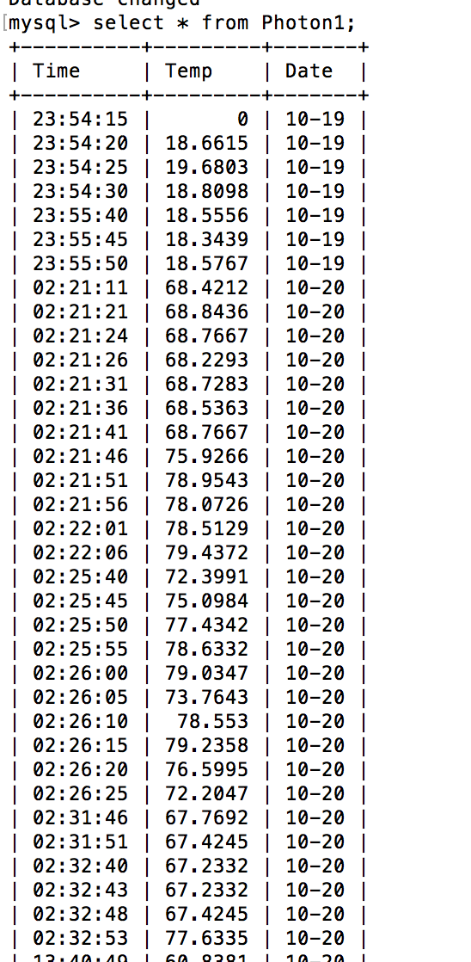
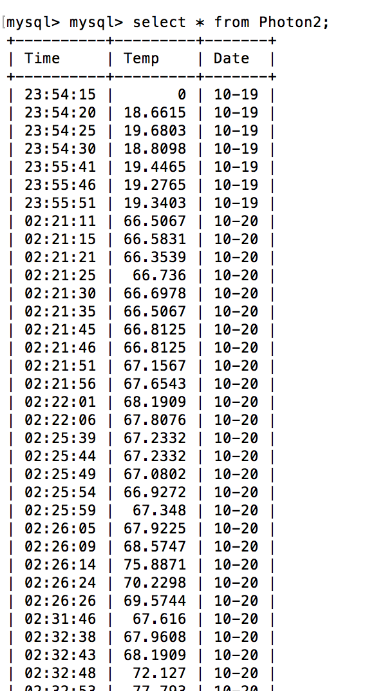
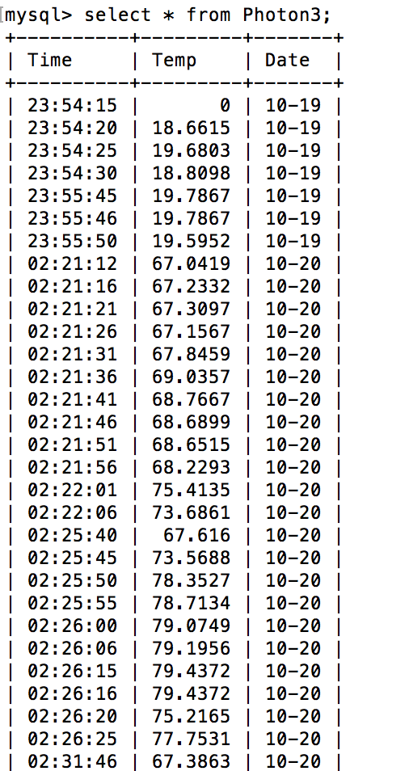
DATA STORAGE METHOD——My sql

Slide 9
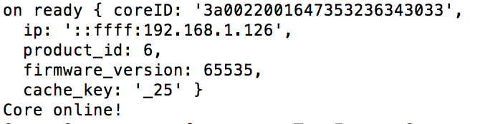
Off-line MODE

Slide 10
Thank you !

